Slide 1
PREPOSITIONS
TIME

Slide 2
1. SEASONS
spring
IN
summer
autumn
winter
What do you do in summer?
In summer I go on holiday.

Slide 3
2. MONTHS
January
February
March
IN
April
May
June
July
August
September
October
November
December
My birthday is in July. And yours?

Slide 4
3. TIME OF DAY
IN
morning
afternoon
evening
What do you do in the afternoon?
In the afternoon I do my homework and then I go out.
!!! BUT : at noon, at night !!!!!!!!!

Slide 5
4.DAYS
Monday
ON
Tuesday
on Christmas Day
Wednesday
on New Year´s Day
Thursday
on my birthday
Friday
on Monday morning
Saturday
on 21 February
Sunday
What do you do on Sunday?
On Sunday I usually visit my Grandma.

Slide 6
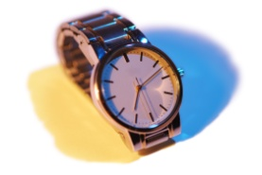
5.PREPOSITION AT
- at night, at noon, at midnight
- at seven o´clock, at half past five
- at the weekend
- at Easter, at Christmas

Slide 7
!!!!!REMEMBER!!!!!
IN + seasons (roční období)
IN + months (měsíce)
IN + time of day (denní doba)
ON + days (dny a názvy dnů)
AT + svátky / čas na hodinkách / víkend / noc, poledne, půlnoc

